Slide 1

Concierge Elite – Benchmark 1
User Interface & High-End Design

Slide 2
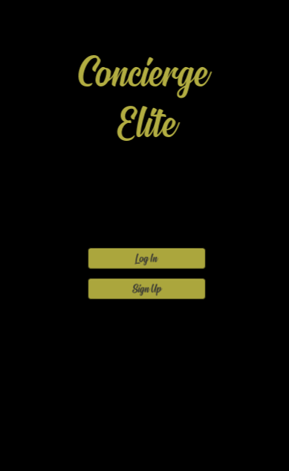
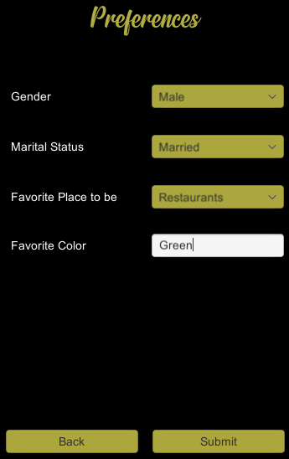

Introduction
Prepared prototype UI…
Maintained 3-tab architecture…
Brainstorming implementation…

Slide 3
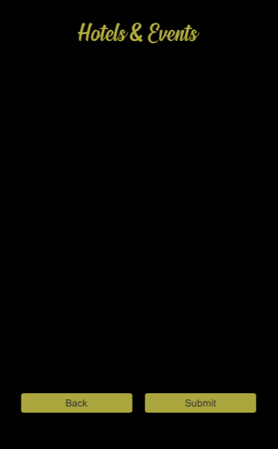
Current Issues
Finding the right API…
Defining the scope of the attractions…
Website porting…

Slide 4

Large Picture Slide
Proposed Fixes/Improvements
Designating approximately 50 attractions for consideration
Pricing…
Continued research regarding APIs and Website Porting…

Slide 5
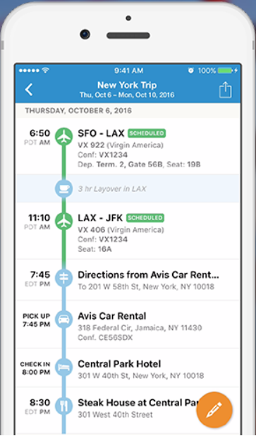
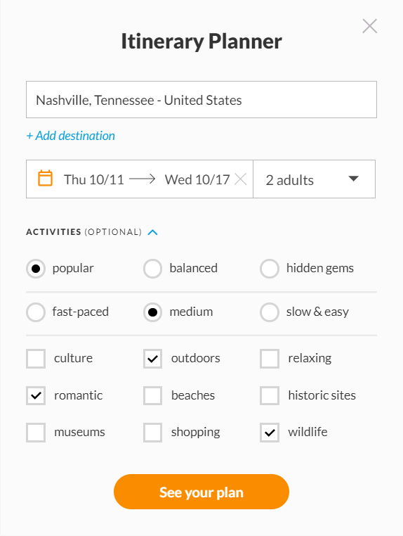
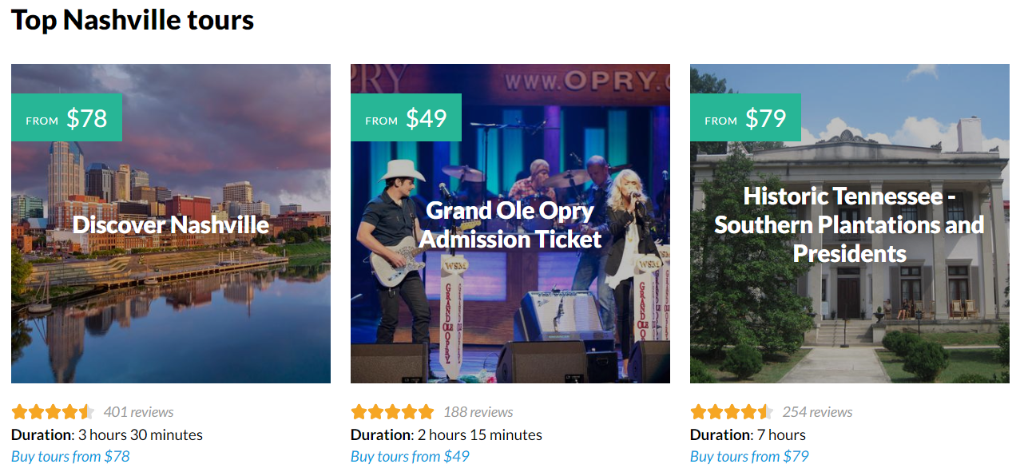
Other Related Sites…
Tripit.com
Inspirock.com

Slide 6



Technology Used
(and why)
Confirmed use of Unity…
Styling options & ease of use
Easier for testing
Various APIs
No other feasible alternatives…
MySQL
Pre-existing familiarity

Slide 7

THANK YOU
SAM GIARRATANA, PRESTON GRAU, MASON SHEPHERD

